Slide 1
Servo Actuated Gimbal
ME417 – Mechatronics Project
Seyit Kubilay ULUÇAY | Tuna ÇELEBİ
S029261 | S028940
1
24/05/2024

Slide 2
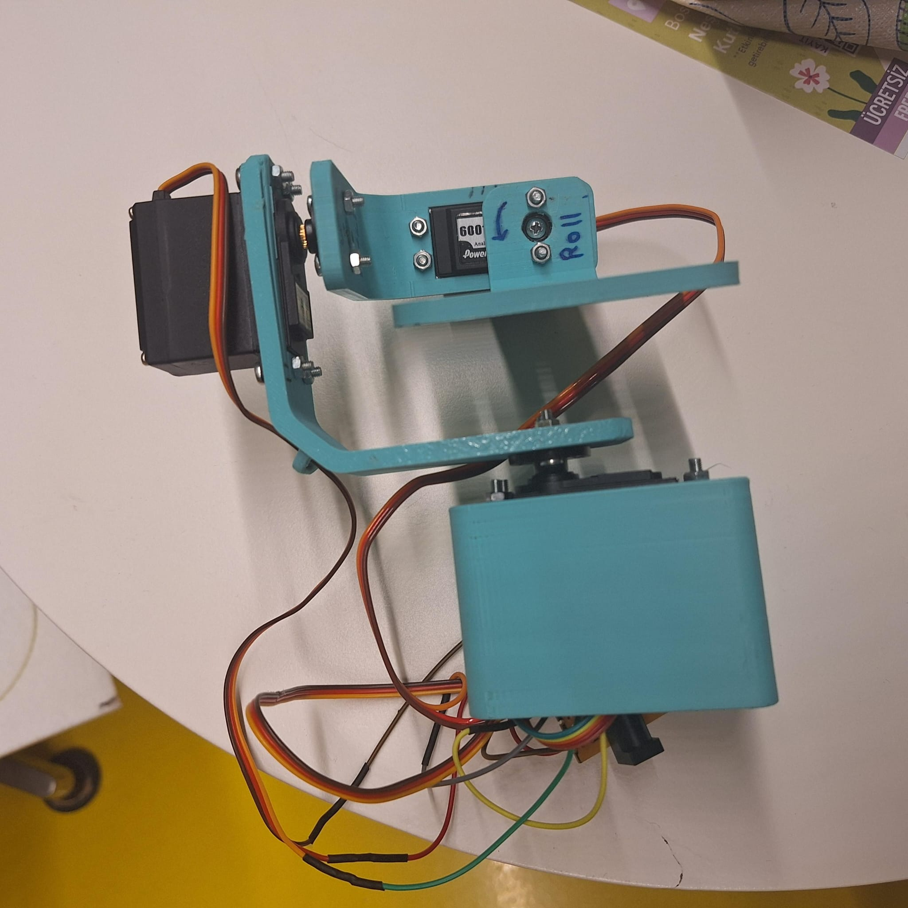
Aim of the project
Creating servo actuated gimbal with MPU605 IMU
1
24/05/2024

Slide 3
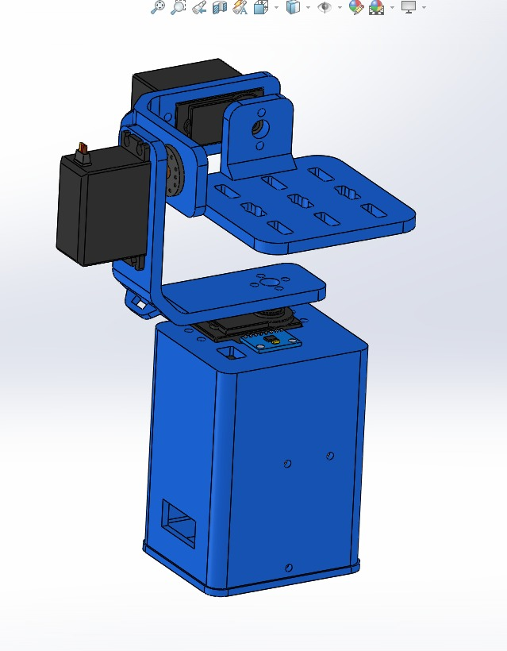
Design
We have found our design from the internet, but we did not just copy and used it, we have modified that model according to our aims and methods.
Initial model was designed to use with Li-Po batteries, since batteries are expensive, we have decided to use 5V adapter to power up the Arduino and control servos.
1
24/05/2024

Slide 4
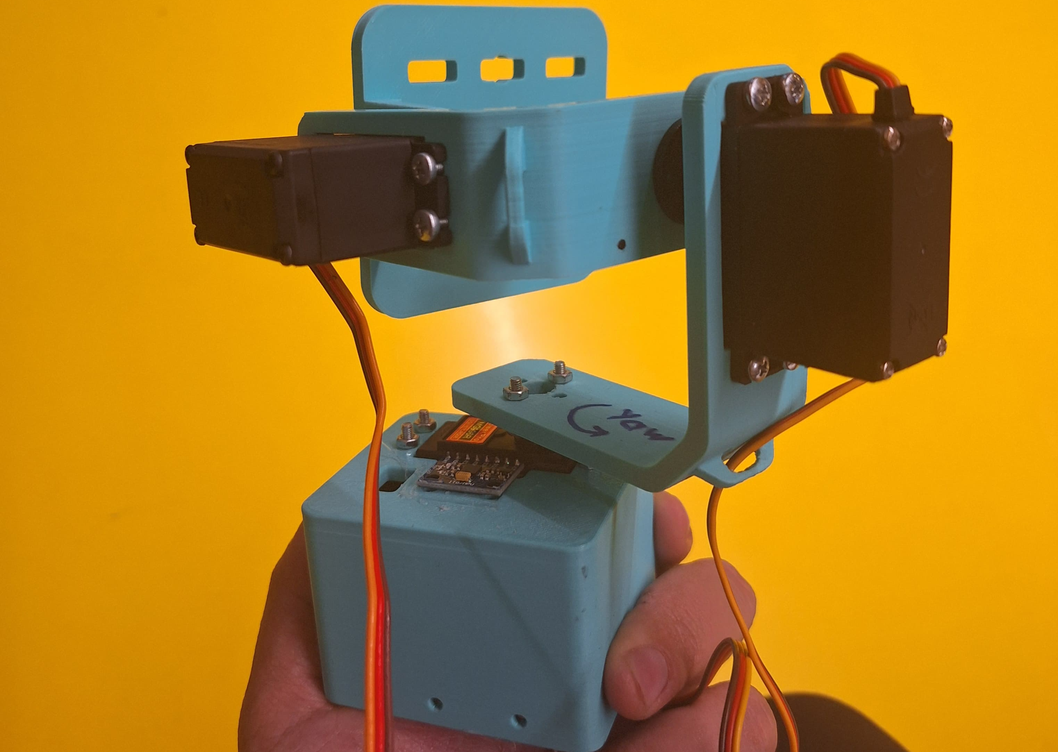
Components
Arduino Nano
3 x Servo (MG996R, 6001, 1201, etc.)
MPU6050 – IMU
M3 Bolts and nuts
Pertinax copper sheet
Cables
5V – Adapter
1
24/05/2024

Slide 5
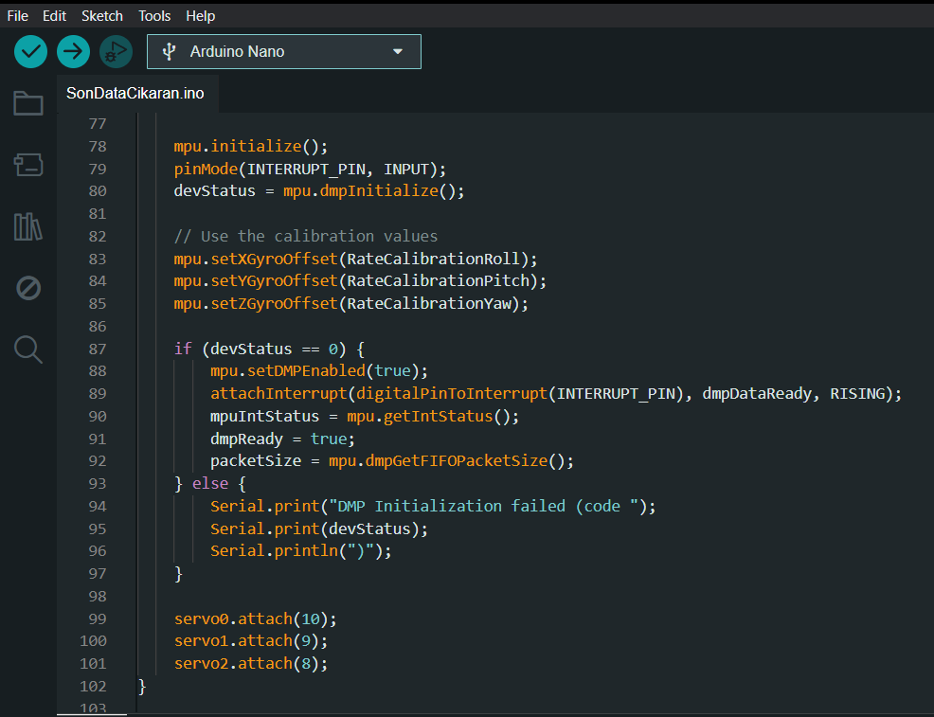
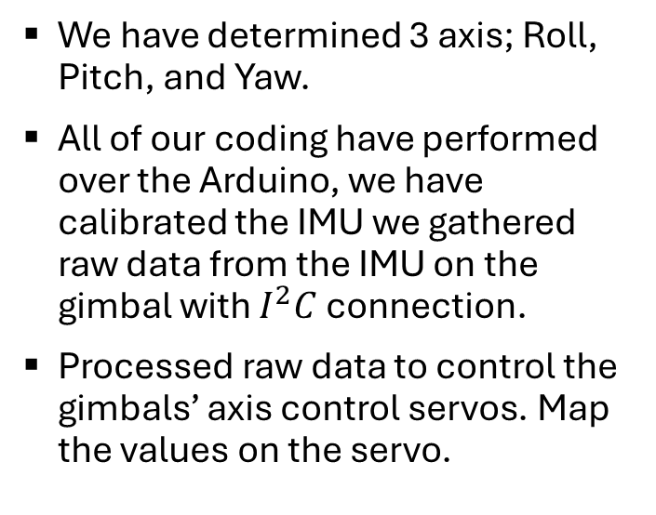
Methods
We have determined 3 axis; Roll, Pitch, and Yaw.
All of our coding have performed over the Arduino, we have calibrated the IMU we gathered raw data from the IMU on the gimbal with $I^{2}C$connection.
Processed raw data to control the gimbals’ axis control servos. Map the values on the servo.
1
24/05/2024

Slide 6
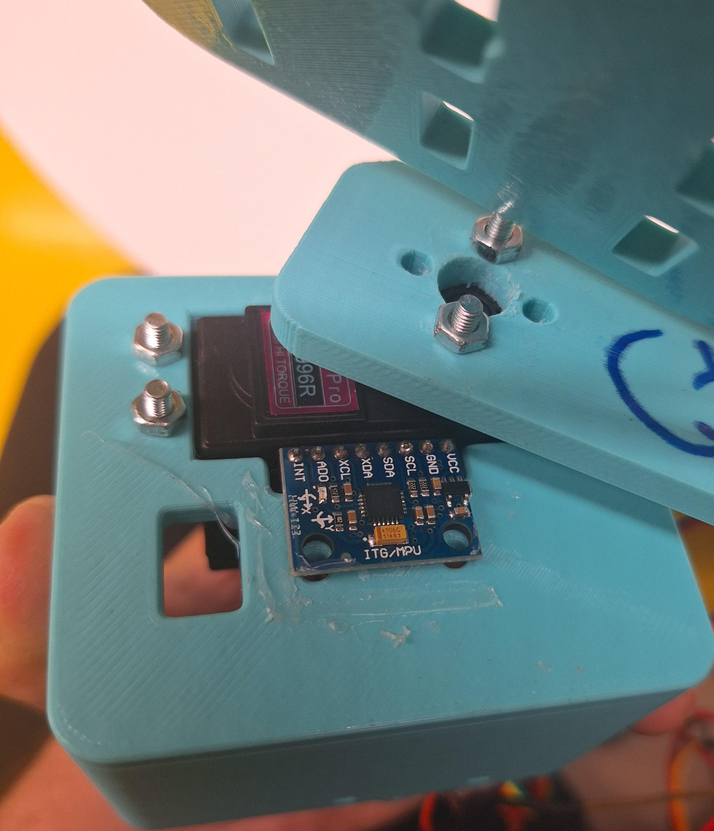
Results
At the end we had to use a phone to gather gyro values from the stabilized part because our first MPU was defective.
We have gathered resaults from the phones’ gyroscope so we can compare the values between IMU on the holding part and stable part of the gimbal.
We gathered values from the IMU in the Arduino, but we had to start data collection with hand. We had two excels with little bit of time difference because of the manual start.
1
24/05/2024

Slide 7
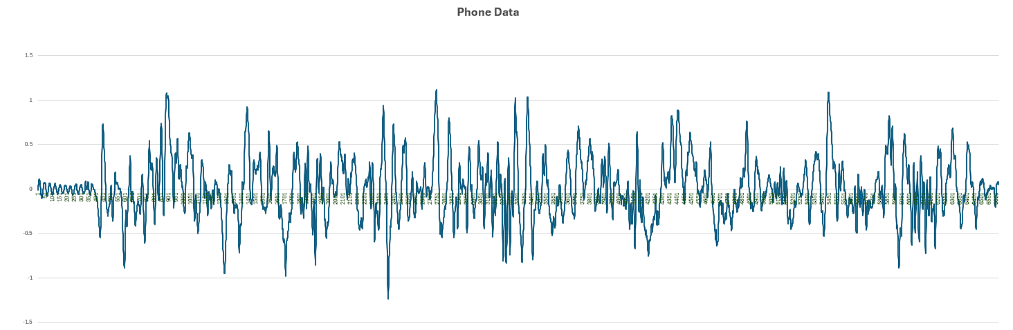
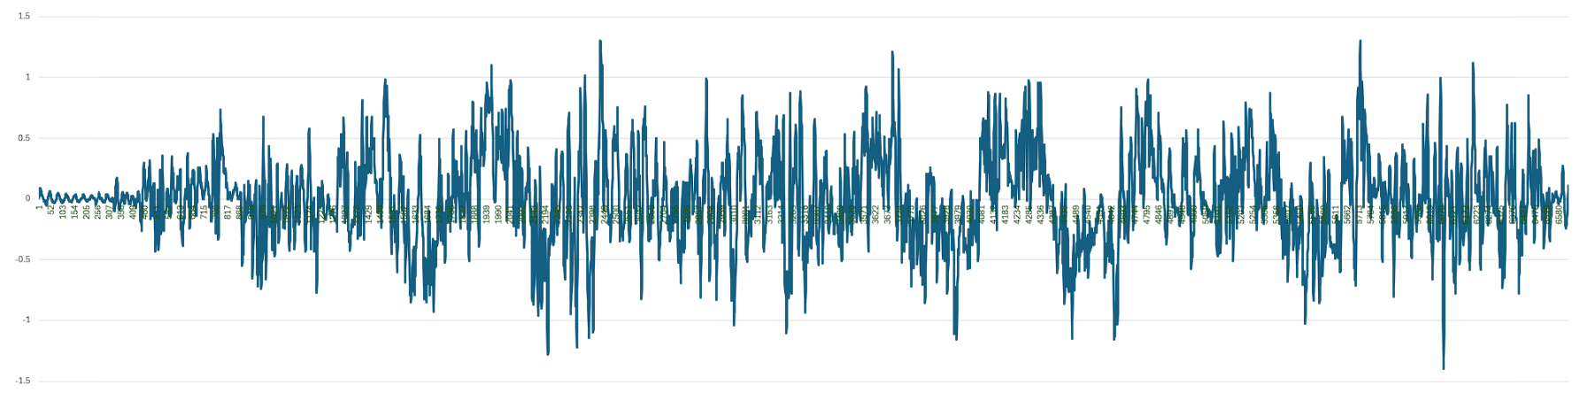
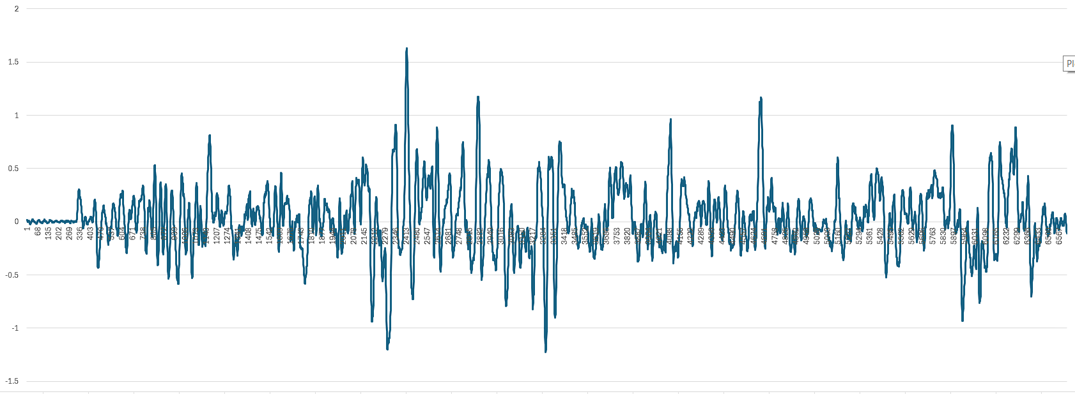
Results
-
Gyro x from phone data
Gyro y from phone data
We had 2 data sets, first one is from the holding point of the Arduino which we call gimbal data and the other hand it is telephone data.
Gyro z from phone data

